Slide 1
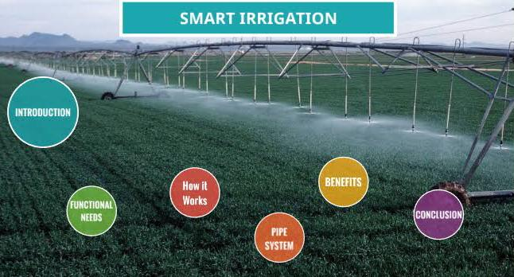
Smart irrigation

Slide 2
Problems statement :
* “Development of real time land usage and monitoring tool by using satellite data and artificial intelligence” which is given by ‘Government of Bihar’
*we have chosen this problem statement because these are one of the real time problems that are facing by farmers .
*By this project we are going to give some real time solutions to farmers.
1.Water Management
2.Over-usage of fertilizers
3.Monitoring and security

Slide 3
Purpose:
• Smart water management System
• Smart analysis of chemical composition
• Smart monitoring and security system

Slide 4
Scope:
1.By this water management system , we can able to calculate the “CROP YIELD PER CUBIC METER USAGE OF WATER” index.
2.By smart analysis , we can able to calculate the “CROP YIELD PER KG OF FERTILIZERS” index.
3.By arranging a CC camera at the top of antenna ,we can monitor the field effectively.
4.By placing a “SIEREN” at the antenna ,we can provide more security to field .

Slide 5
Objective:
We can decrease the over-usage of water
We can increase the cultivating area with the same amount of water.
We can be able to know the type of nutrients present in soil.
It helps us to find the decaying nutrients in the soil.
It helps us to know the requirement of nutrients to the crops.
It helps us to monitor the field from anywhere.

Slide 6
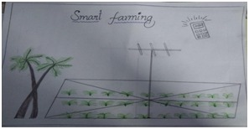
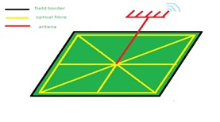
System Architecture:
1.We arrange the FBG sensor cables diagonally and boders of the field.
2.We place the antenna at the middle of the field with the programmable device.
3.We connect all the FBG cables to antenna or device.
Fig.a
Fig.b

Slide 7
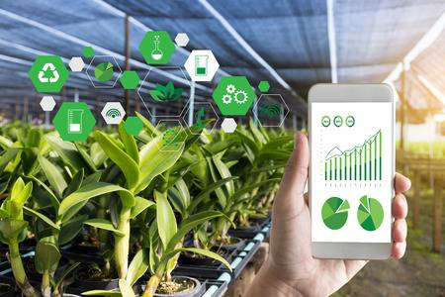
Smart water Management system
Let’s consider 1 acre of land and having an antenna at the center of the field and arrange the “FBG” sensor cables diagonally to all the corners of the field inside the soil surface
ones the water reaches the roots of the plants ,the “FBG” cables will send the signal to programmed device at antenna and that device will send the alert messages to the farmers .

Slide 8
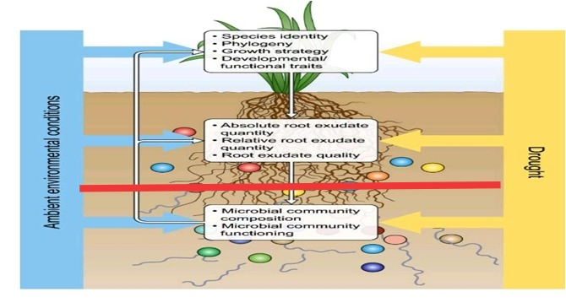
Smart analysis of chemical composition
• Today the farmer don’t known the which type of nutrients present in the soil . Here , we place the “FBG” cables inside the soil surface and that cables will analyze the chemical changes in the soil.
• Then will send the data to the programmed device at the antenna and this data is transferred to the farmer.By this analysis we can decrease the over-usage of fertilizers .

Slide 9
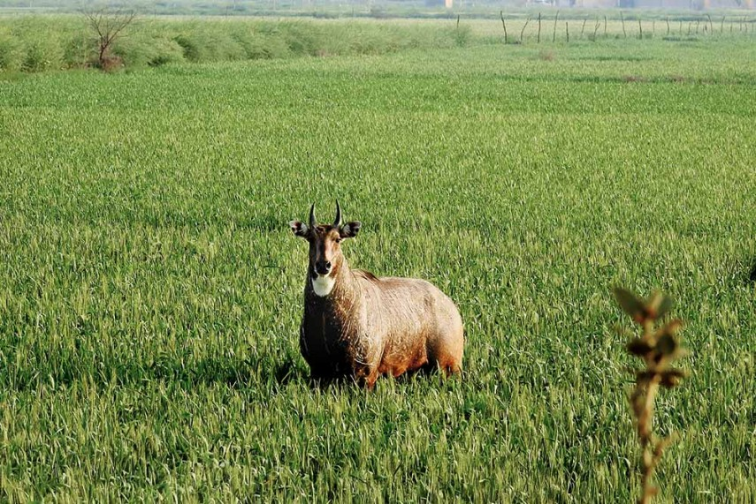
3.SMART MONITORING AND SECURITY SYSTEM
Now a days , farmers are using electric fencing around the field in order to protect from animals
• But this system is very dangerous to humans and useful animals like buffalos , cows and bulls.
• In our project we are going to arrange the “FBG” cables around the borders of the fields
In case , any animal entered into the field ,due to pressure on surface ,the cables will send the alert messages to the farmers

Slide 10
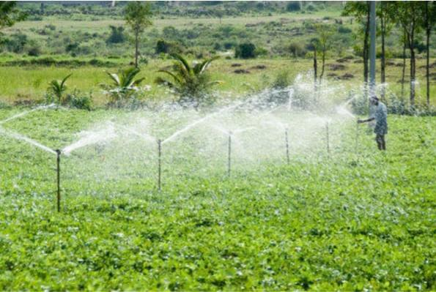
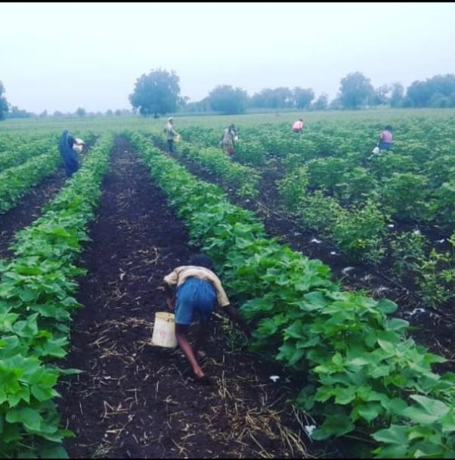
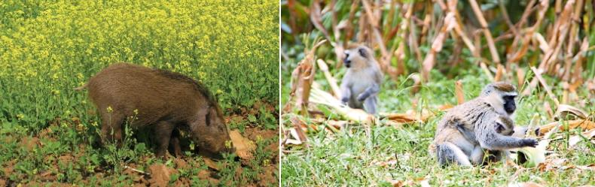
Survey:
•Mis-management of water
Our country cultivating only 183 million hectares of
land
Even , india getting 400 millions of precipitation and
163 million cubic meter ground water
Over usage of fertilizers
Indian farmers using 128 kg/ha NPK and this number is
increasing every year
Extreme consumption of fertilizers leads to depletion
of land
Threat from wild animals
It is also big issue in our country ,for example kerala
elephants creating lot of damage to farmers.

Slide 11
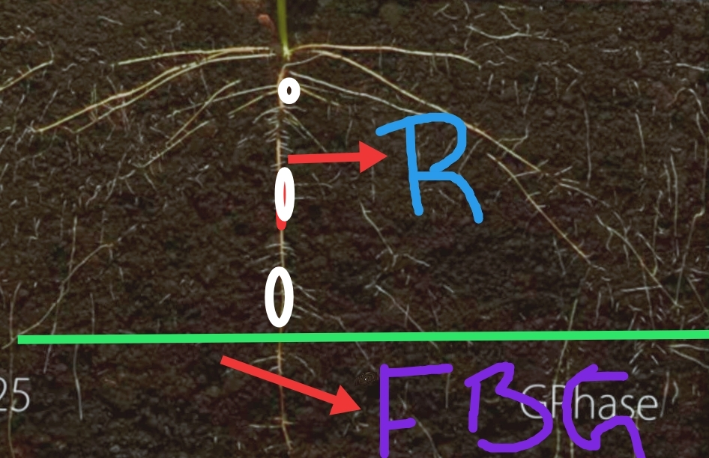
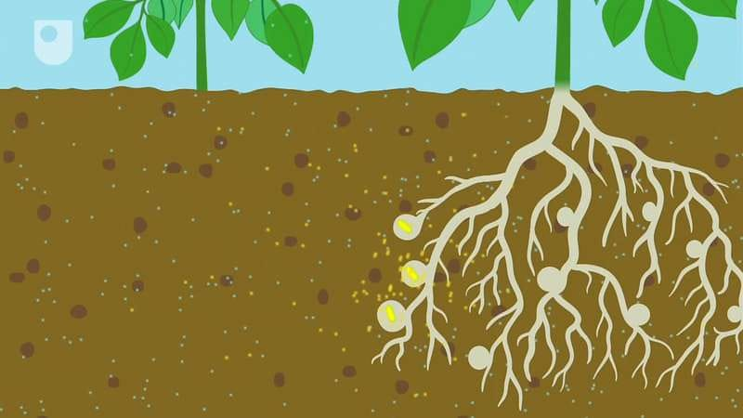
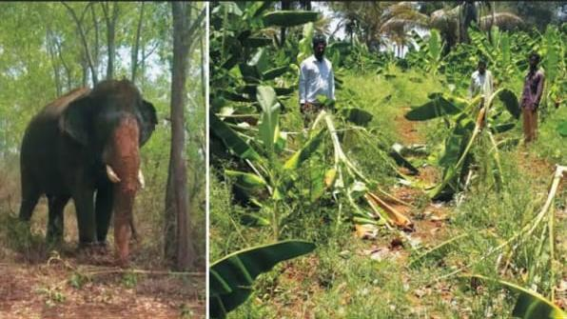
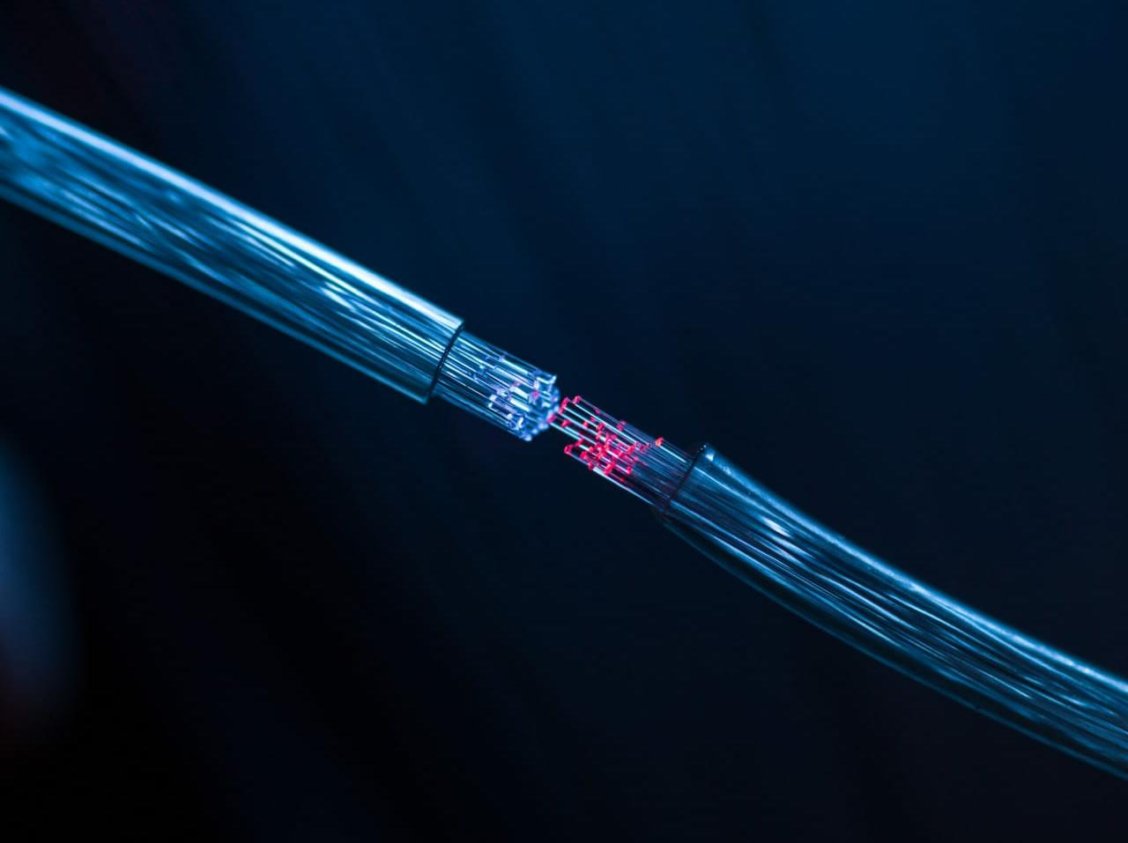
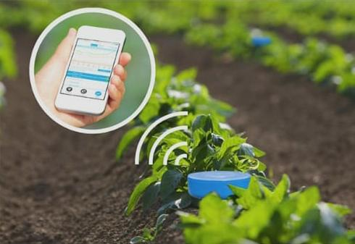
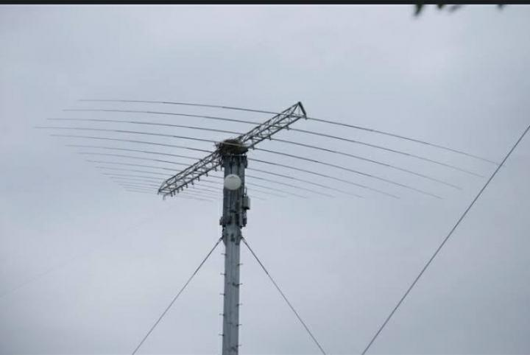
MODULUS

Slide 12
CONCLUSION:
We can conclude that by using this respective methods, We Will be able to estimate the required quantity of water and nutrients reaching to the crop, So that farmers can be able to get a healthy crop yield.
• Efficient usage of water
• More land can converted into cultivation
• It reduce the over-usage of fertilizers ,by this we can decrease the “finical burden” on farmers.
• It helps us to maintain the real-time health data of the crop
• Less manpower requirement
• It reduce the soil depletion

Slide 13

Mentors:
1.Gopi krishna Rao Panayam vuppu
2.Venkata krishnaiah Kummara
Presented by:
1.Patil Saiabhin 4.Sai kiran yadav M
2.Langaluru Sai Thrivikram 5.Thummalasetty Sai Charishma
3.Rakesh kurni 6.Shaik Naseeha Nouseen

Slide 14


JAI KISAN
THANK YOU....

